Slide 1
Connect+

Slide 2
Introduction
Connect+ is a web platform designed to streamline skill development and time management. Whether you're a professional or student, Connect+ offers personalized learning paths tailored to your goals. With built-in task scheduling and progress tracking, it helps you manage time efficiently and stay on course. Achieve steady growth and unlock your potential with Connect+—where focus meets flexibility.

Slide 3


Problem Statement: Efficient Skill Development and Time Management through a Diverse Learning Roadmap
In today’s competitive environment, individuals struggle to acquire specialized skills while managing diverse learning goals. Many systems lack personalization and efficient roadmaps, leading to poor task prioritization, burnout, and incomplete skill development.
Objective: To build a web-based platform offering:
Specialized Learning Paths
Efficient Time Management
Progress Tracking
Balanced Learning

Slide 4
Literature Survey
Section header

Slide 5
Adaptive Learning
Relevance to CS Dept
Challenges
Uses ML algorithms to tailor educational content.
Boosts engagement by adapting to skill level, knowledge gaps, and pace.
Bridges varying knowledge levels in students.
Offers immediate feedback and personalized suggestions (e.g., Gikandi & Morrow).
Requires large datasets for training.
Privacy concerns addressed by federated learning (Lee & Carver, 2023).

Slide 6
Competency
Self-Paced Learning
Gamification
Focuses on mastering skills before advancing.
Critical in CS (e.g., mastering algorithms before advanced topics).
Students progress at their own pace.
Benefits: Improved retention & satisfaction (Zilberman et al., 2021).
Gamified elements (badges, progress bars) boost engagement.
Visual progress tracking motivates and helps students track achievements (Gomez et al., 2022).

Slide 7

Problem Domain
Limitations of Current Systems: - Lack of personalized learning paths and time management tools. - Insufficient progress tracking and career alignment.
Need for Improvement: - Demand for tailored roadmaps and better feedback mechanisms. - Bridging the gap between education and industry needs.
Accessibility and Engagement Issues: - Lack of gamification and inclusive design (e.g., screen reader compatibility). - Limited feedback mechanisms hinder motivation and retention.

Slide 8

SOLUTION
We will develop a web application that generates personalized learning roadmaps for computer science students based on their chosen skillset, available time duration, and goals.
1. User Profile and Goals Setup:
Skill Selection: Users select their area of interest (e.g., programming, machine learning, cloud computing, etc.).
Current Knowledge Assessment: Short quizzes or self-assessments to evaluate the user's existing knowledge level.
Time Commitment: Users input their available hours per week (e.g., 5, 10, or 20 hours), and the app tailors the roadmap accordingly.
Goal Specification: Users set their goals, such as completing a certification, mastering a language, or landing a specific job role (e.g., front-end developer, data analyst, etc.).

Slide 9
SOLUTION
2. Content Curation:
The app integrates with online learning platforms (e.g., Coursera, edX, freeCodeCamp, YouTube) to recommend the best resources for each topic.
The platform will also highlight free vs. paid resources, allowing users to pick based on their budget.
3. Career Integration:
The web app will provide career-oriented insights, such as which skills are currently in demand in the job market and salary ranges for specific roles.
Job matching: Integration with platforms like LinkedIn or Indeed to help users find internships or job opportunities based on their progress.

Slide 10
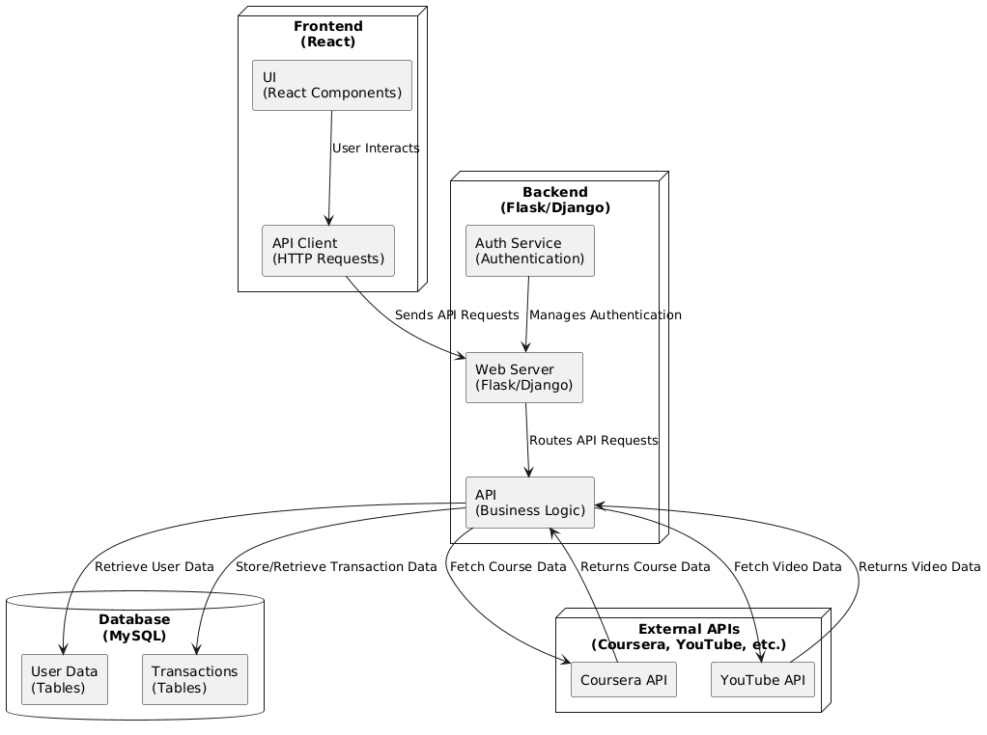
System Architecture

Slide 11
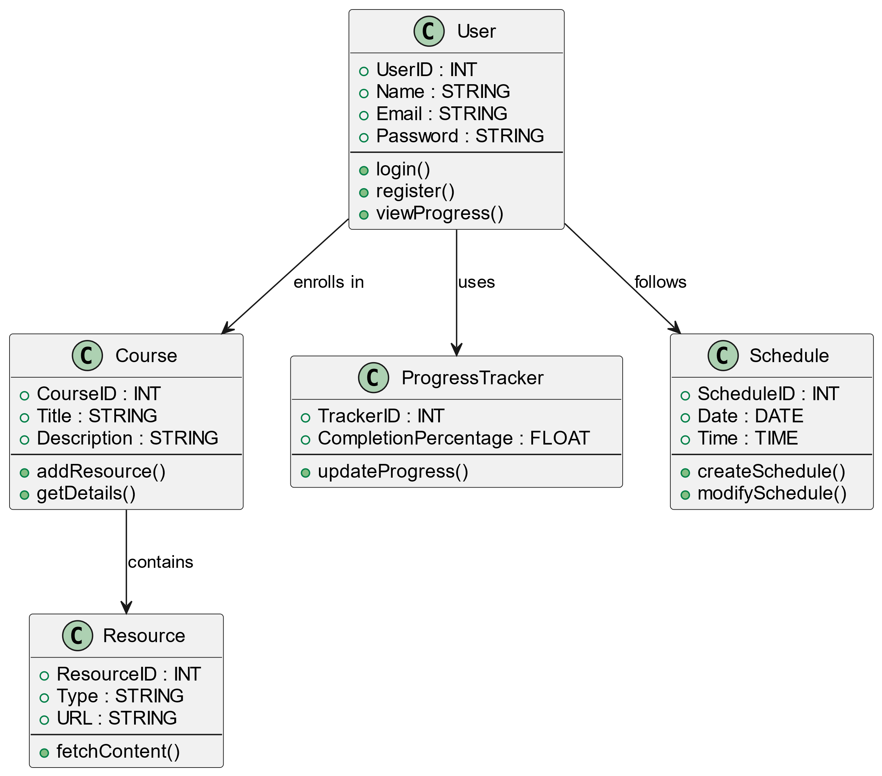
Class Diagram

Slide 12
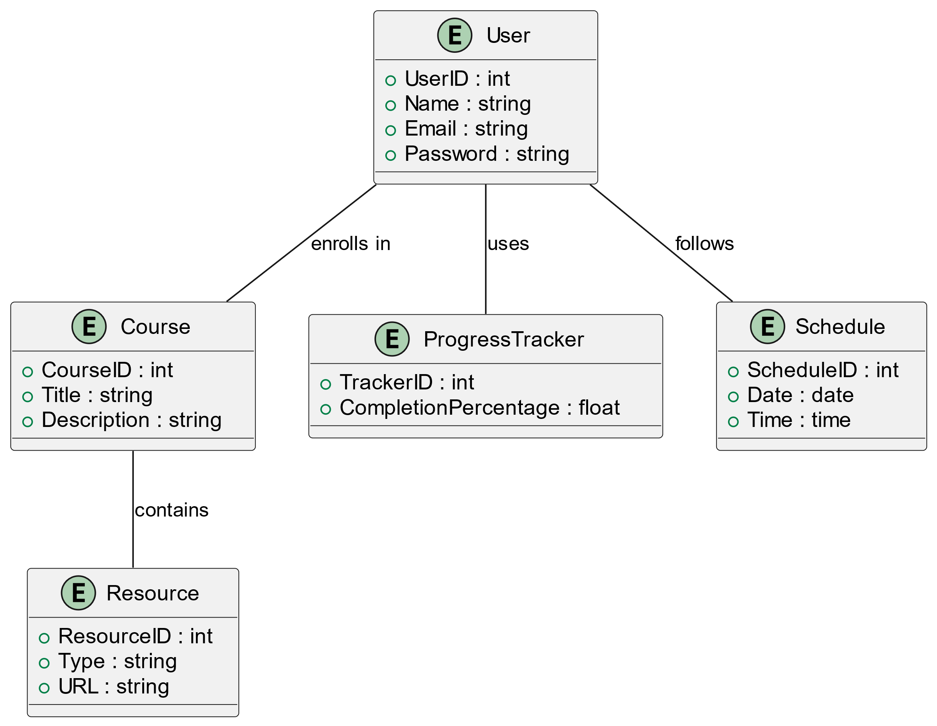
ER Diagram

Slide 13
Proposed Methodology
Hybrid Approach: - Combines Agile and Prototype models.
Workflow: - Develop prototype → Gather feedback → Iterative sprint development → Deployment.
Deployment Phase: - Comprehensive testing ensures a polished and functional product. - Iterative feedback loops improve user experience.

Slide 14
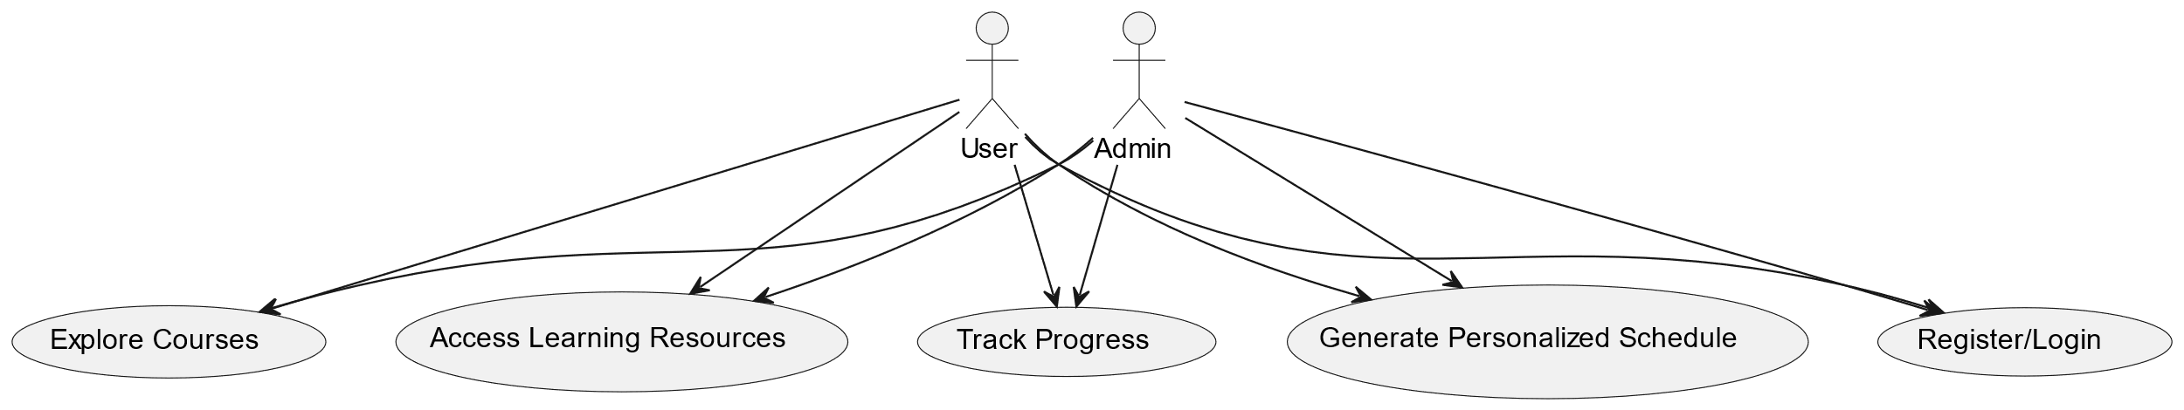
Use Case Diagram

Slide 15
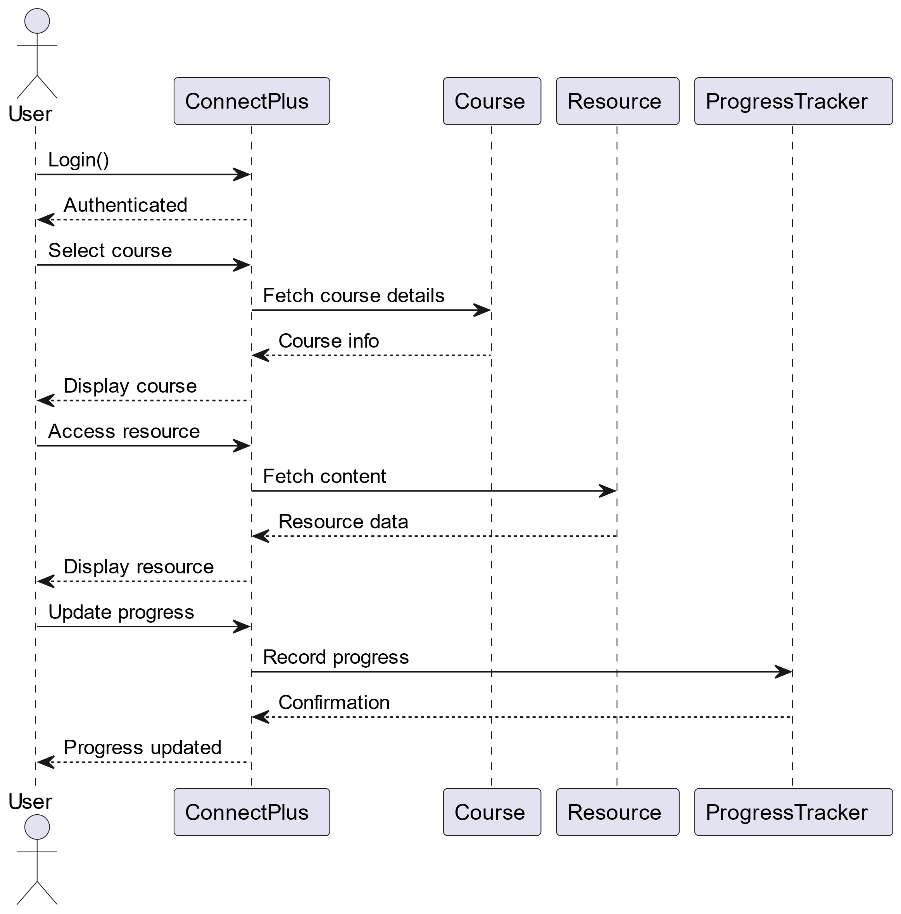
Sequence Diagram

Slide 16
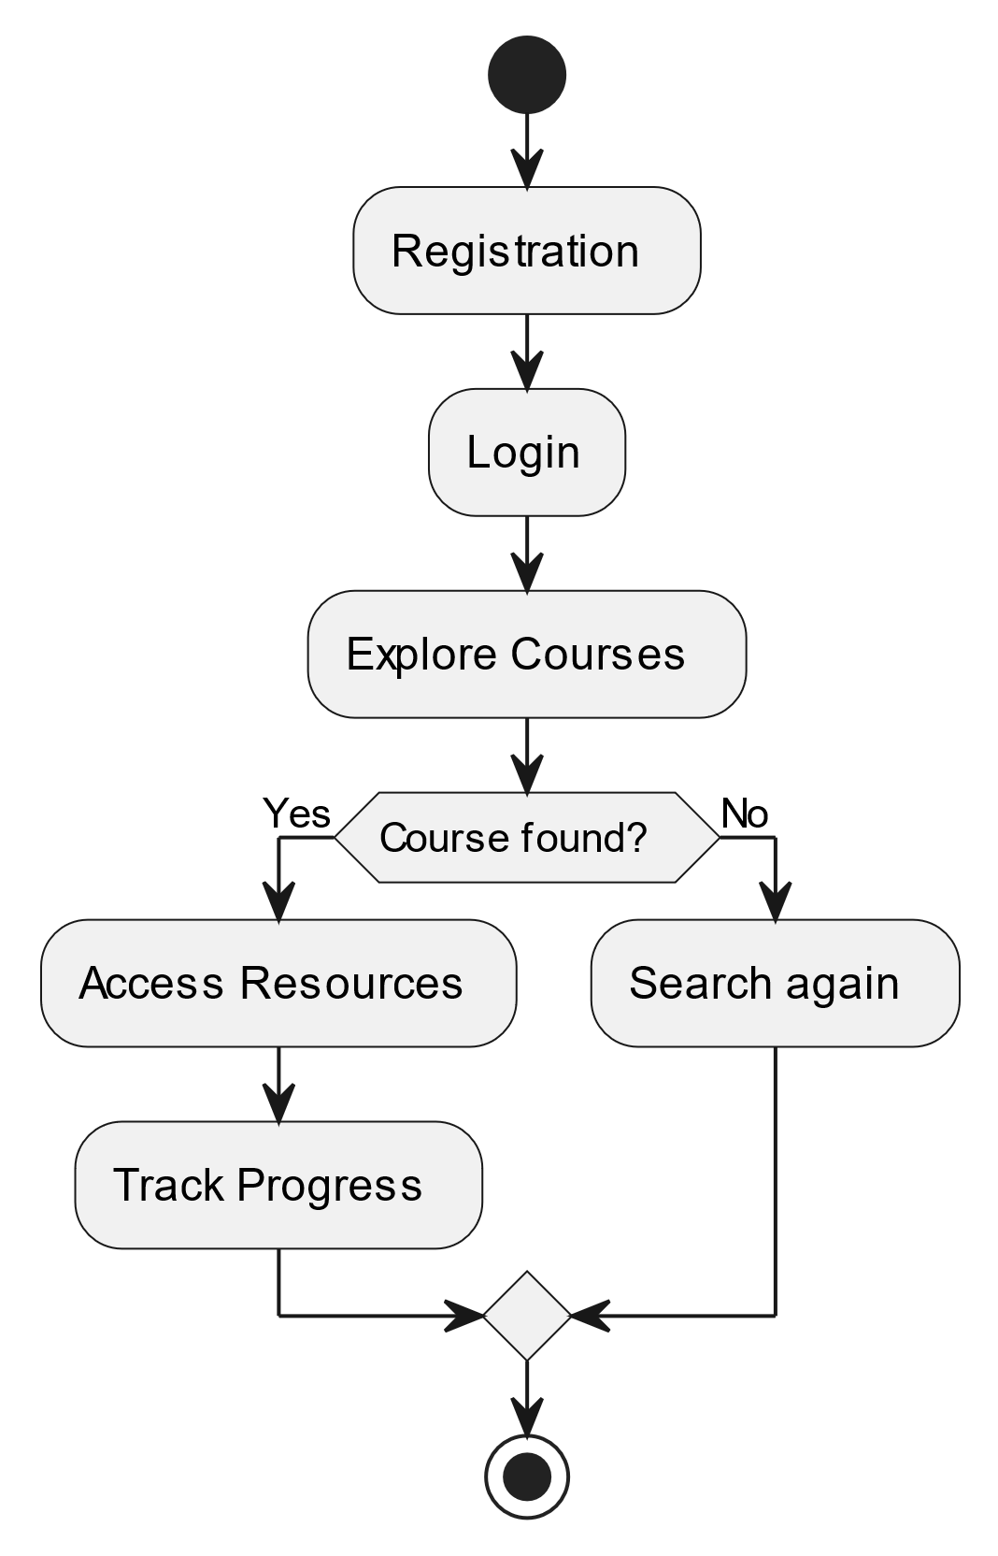
Flow Chart

Slide 17
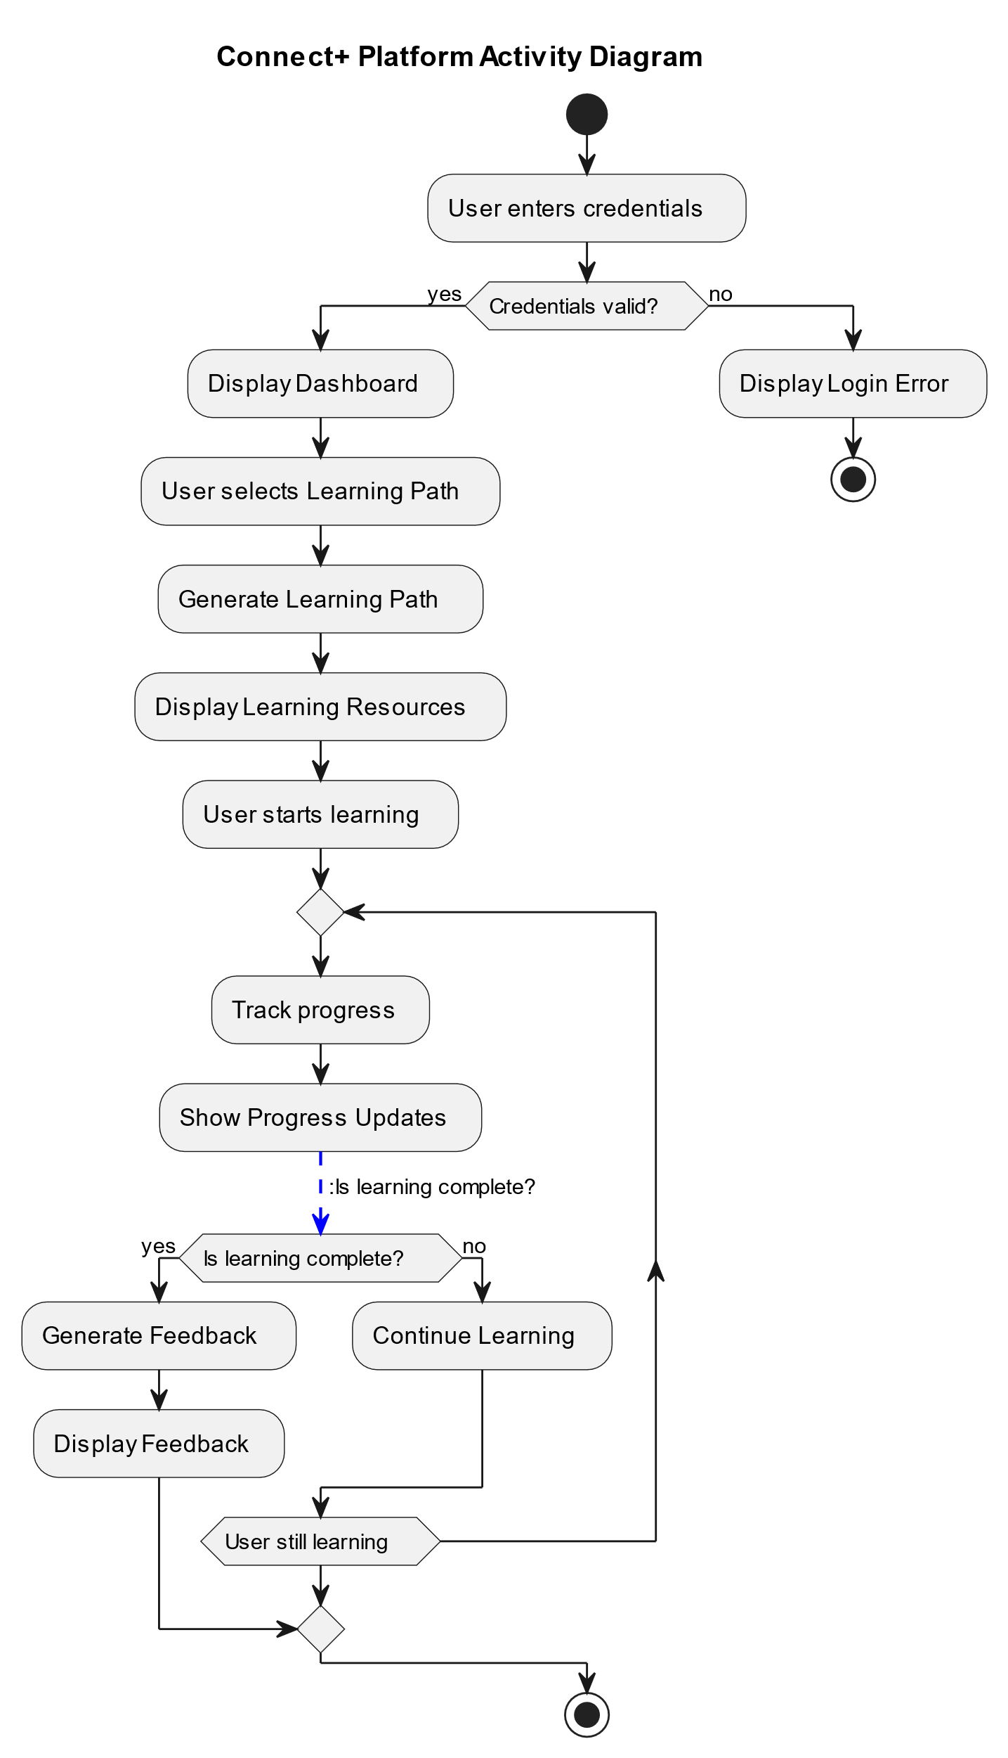
Activity Diagram

Slide 18
.
Section header
Requirements Overview
Functional Requirements: - User registration, personalized roadmaps, progress tracking, and alerts.
Non Functional Requirements: - Scalability for 10,000+ users, intuitive UI, and 99% uptime.
Technical Requirements: - Python with Django for backend logic and API handling. - React.js for dynamic and responsive UI design.

Slide 19
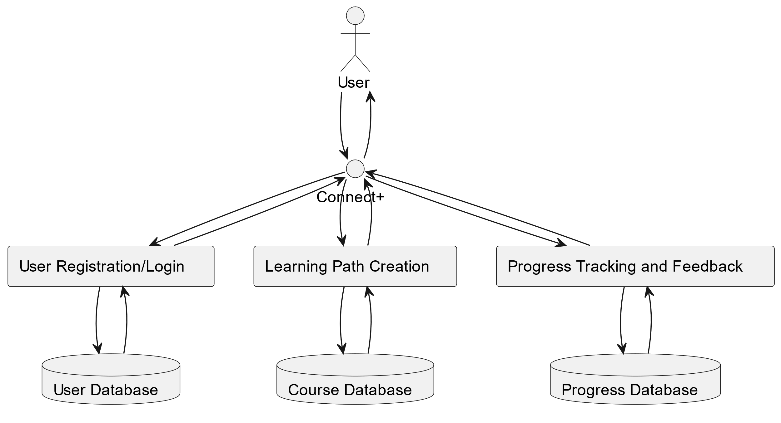
Data Flow Diagram

Slide 20




TECH-STACK
Frontend
HTML, CSS, and JavaScript for building the user interface and providing interactivity.
Backend
Python with Django for handling server-side logic and managing databases.
Database
SQLite for storing user data and progress tracking.
Docker and Nginx for containerization and serving the application. This stack provides a solid foundation for building a scalable, efficient platform.
Deployment

Slide 21
CONCLUSION
This project addresses a common challenge faced by individuals when learning new skills, such as coding, or design: they often lack a clear starting point and structured path for progression. The proposed solution is a web application that generates personalized learning roadmaps, tailored to the user’s specific goals, current knowledge level, and available time.
As users advance, the app dynamically adjusts the suggested courses, books, and projects, ensuring that the learning journey remains relevant and effective. What distinguishes this project is its focus on individualized learning experiences and real-time progress tracking, allowing users to see measurable results and maintain motivation throughout the process.

Slide 22
FUTURE WORK
01
03
Expansion of Learning Streams
02
Adaptive Learning Paths
04
AI-Enhanced Personalization
Deeper Insights and Analytics

Slide 23
FUTURE WORK
Expansion of Learning Streams: We plan to incorporate a broader range of learning streams, covering various skill areas such as business, arts, sciences, and technology. This will make the platform accessible to users from diverse fields and interests.
AI-Enhanced Personalization: In the future, we will integrate advanced technologies, such as artificial intelligence, to provide more personalized learning roadmaps. AI will help tailor recommendations based on user preferences, learning styles, and performance.
Adaptive Learning Paths: The platform will offer more precise and adaptive learning suggestions as users progress, ensuring they receive content that is aligned with their current needs and goals.
Deeper Insights and Analytics: By utilizing AI-driven insights, the platform will provide users with more in-depth analytics on their learning journey, helping them understand their progress and areas for improvement. These future enhancements will ensure the platform continues to evolve as a comprehensive and dynamic tool for skill development.

Slide 24
References
IEEE Xplore Digital Library
ACM Digital Library
SpringerLink
Education and Information Technologies (EAIT)
Journal of Educational Technology & Society
Google Scholar
LinkedIn Learning Blog and Insights
EdTech and Education Dive
ResearchGate
OECD iLibrary
Semantic Scholar

Slide 25
TEAM MEMBER DETAILS
Team Leader Name:
Yash Khandelwal
Branch(B.Tech), CSE, 3rd Year
Team Member 1 Name:
Vinay Patidar
Branch(B.Tech), CSE, 3rd Year
Team Member 2 Name:
Vedika Mishra
Branch(B.Tech), CSE, 3rd Year

